Slide 1

Frailty models
Steve Simon for
Notes:
Analyzing Repeated Measures Data Workshop: Module 5 The Linear Mixed Model
Copyright 2011 The Analysis Factor http://TheAnalysisFactor.com
1

Slide 2
Abstract
Lecture 7.
Lecture 7. Frailty models. You can incorporate multiple events per patient and account for center effects using frailty models, the survival data analysis equivalent to mixed models in linear regression. You’ll see how to define random effects and how to fit and interpret these models.

Slide 3
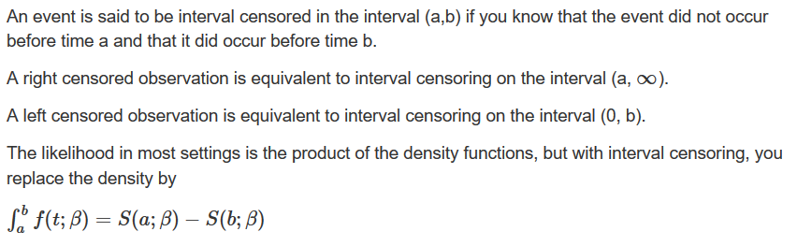
Interval censored data

Slide 4
Interval censored data
Left truncation
In most studies, patients are considered part of the risk set from time 0 to the time that they either die or are censored. But sometimes patients start contributing information about survival only from a certain point forward. This is left truncation.
Example: Patients who die in the hospital are excluded from your sample. A patient contributes to the risk set from the day of discharge onward. Setting the time of discharge to t=0 will mix patients with short and long lengths of stay.

Slide 5
Interval censored data
Left censored and left truncated are opposites
Right censored. Event occurred sometime after last observed time.
Left censored. Event occurred sometime before the first observed time.
Left truncated. The patient does not contribute information about the risk of the event prior to the first observed time.

Slide 6
Left truncation, example
math.usu.edu/jrstevens/biostat/projects2013/pres_LeftTruncation.pdf
sex age time death age2
1 female 51 1 death 52
2 female 58 1 death 59
3 female 55 2 death 57
4 female 28 22 death 50
5 male 21 30 censor 51
6 male 19 28 death 47

Slide 7
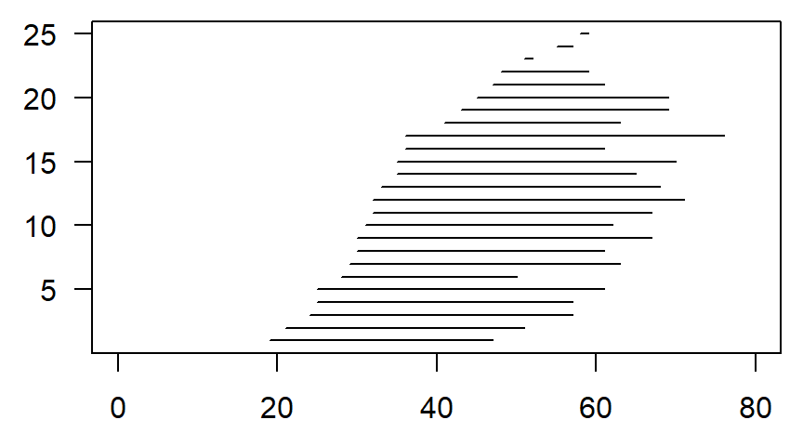
Left truncation, example

Slide 8
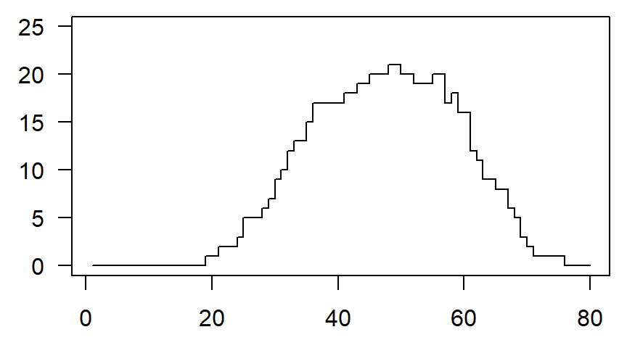
Left truncation, patients at risk

Slide 9
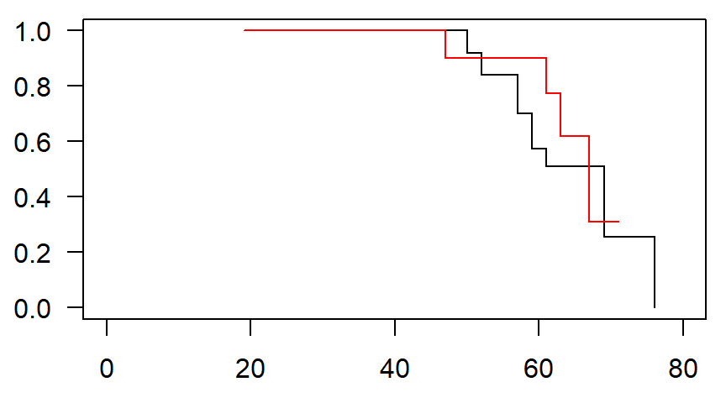
Left truncation, survival curves

Slide 10
Frailty models
Settings
Frailty models account for correlation within a group.
Multiple events for the same person.
Multiple sites on the same person.
Multiple people in the same family
Multiple animals in the same litter.
Multiple visitors in the same hospital
Multiple students in the same classroom/school.

Slide 11
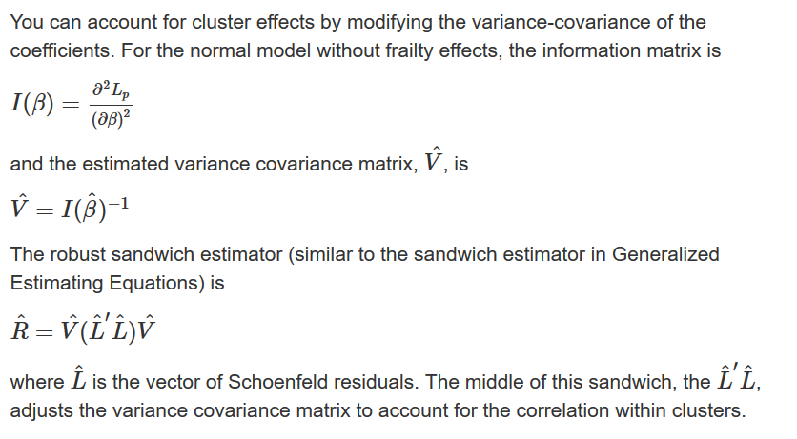
Cluster models

Slide 12
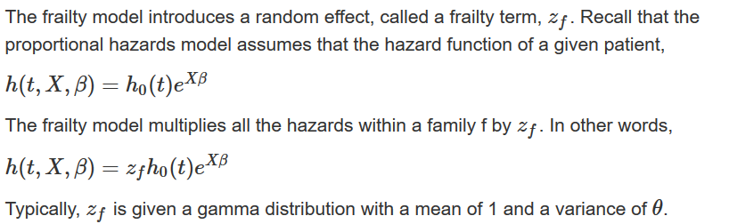
Frailty models

Slide 13
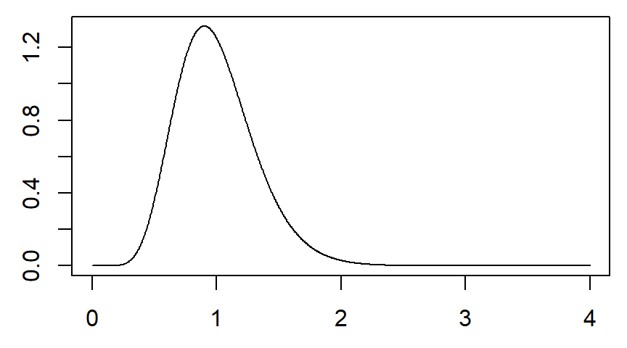
Frailty models

Slide 14
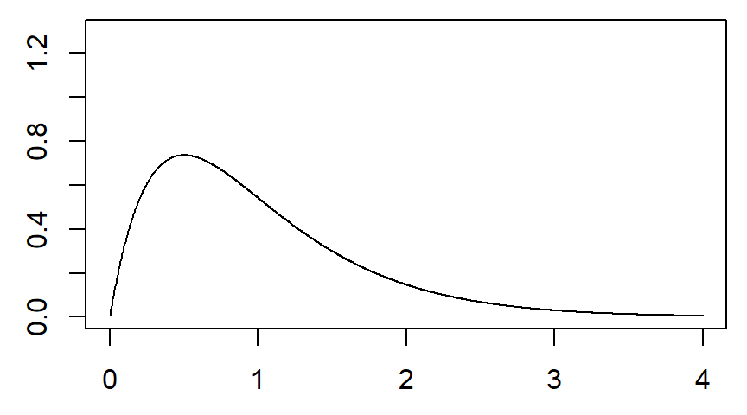
Frailty models

Slide 15
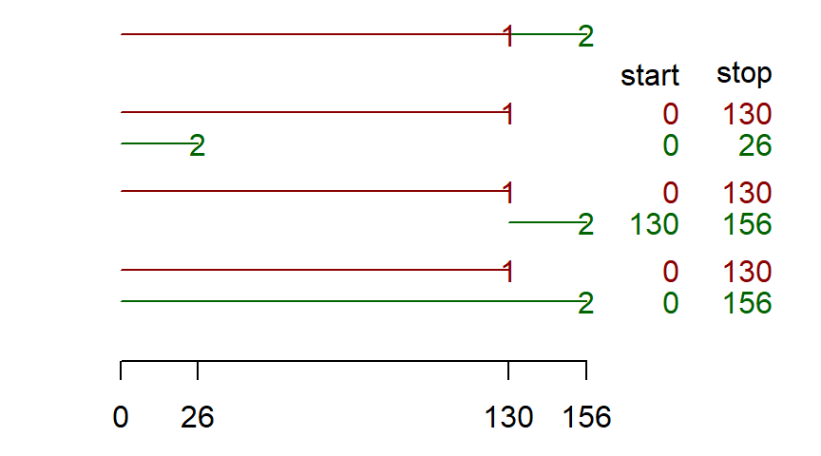
Three models for repeated events

Slide 16
Conclusion
What have you learned today?

